Slide 1
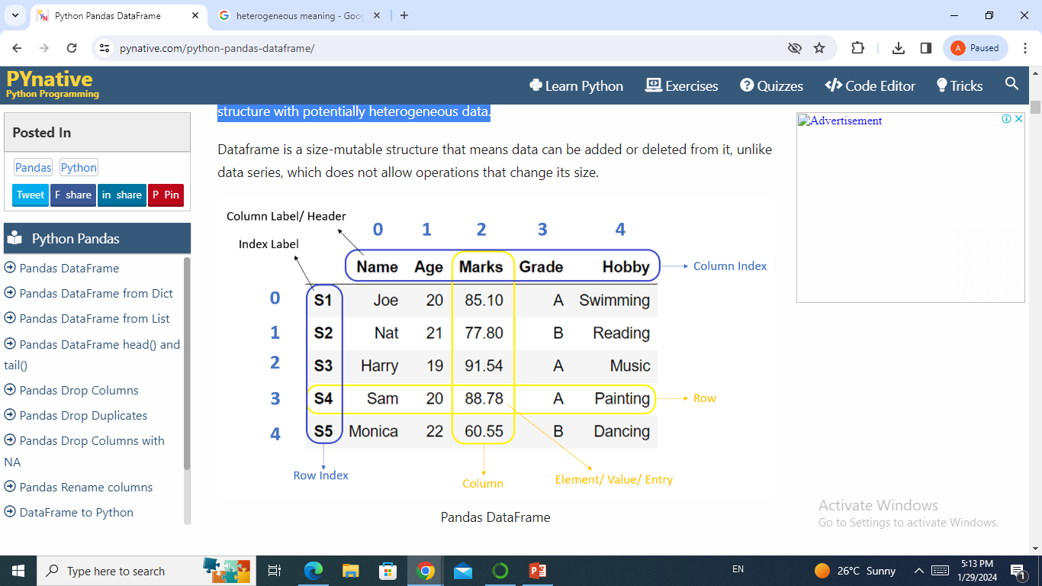
What is DataFrame in Pandas
Dataframe is a tabular(rows, columns) representation of data. It is a two-dimensional data structure with potentially heterogeneous data.

Slide 2
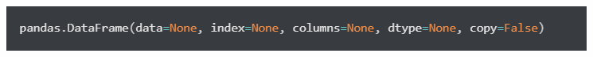
DataFrame creation
Data is available in various forms and types like Excel, CSV, SQL table, JSON, or Python structures like list, dict etc. We need to convert all such different data formats into a DataFrame so that we can use pandas libraries to analyze such data efficiently.
To create DataFrame, we can use either the DataFrame constructor or pandas’ built-in functions. Below are some examples.
DataFrame constructor

Slide 3
Parameters:
data: It takes input dict, list, set, ndarray, Iterable, or DataFrame. If the input is not provided, then it creates an empty DataFrame. The resultant column order follows the insertion order.
index: (Optional) It takes the list of row index for the DataFrame. The default value is a range of integers 0, 1,…n.
columns : (Optional) It takes the list of columns for the DataFrame. The default value is a range of integers 0, 1,…n.
dtype : (Optional) By default, It infers the data type from the data, but this option applies any specific data type to the whole DataFrame.
copy : (Optional) Copy data from inputs. Boolean, Default False. Only affects DataFrame or 2d array-like inputs

Slide 4
Dataframe from CSV
In the field of Data Science, CSV files are used to store large datasets. To efficiently analyze such datasets, we need to convert them into pandas DataFrame.
To create a DataFrame from CSV, we use the read_csv('file_name') function that takes the file name as input and returns DataFrame as output.
cars = pd.read_csv("Automobile_data.csv") print(cars)

Slide 5
Metadata info of DataFrame
DataFrame.info() is a function of DataFrame that gives metadata of DataFrame. Which includes,
Number of rows and its range of index
Total number of columns
List of columns
Count of the total number of non-null values in the column
Data type of column
Count of columns in each data type
Memory usage by the DataFrame

Slide 6
Get the statistics of DataFrame
DataFrame.describe() is a function that gives mathematical statistics of the data in DataFrame. But, it applies to the columns that contain numeric values.
count: Total number of non-null values in the column
mean: an average of numbers
std: a standard deviation value
min: minimum value
25%: 25th percentile
50%: 50th percentile
75%: 75th percentile
max: maximum value

Slide 7
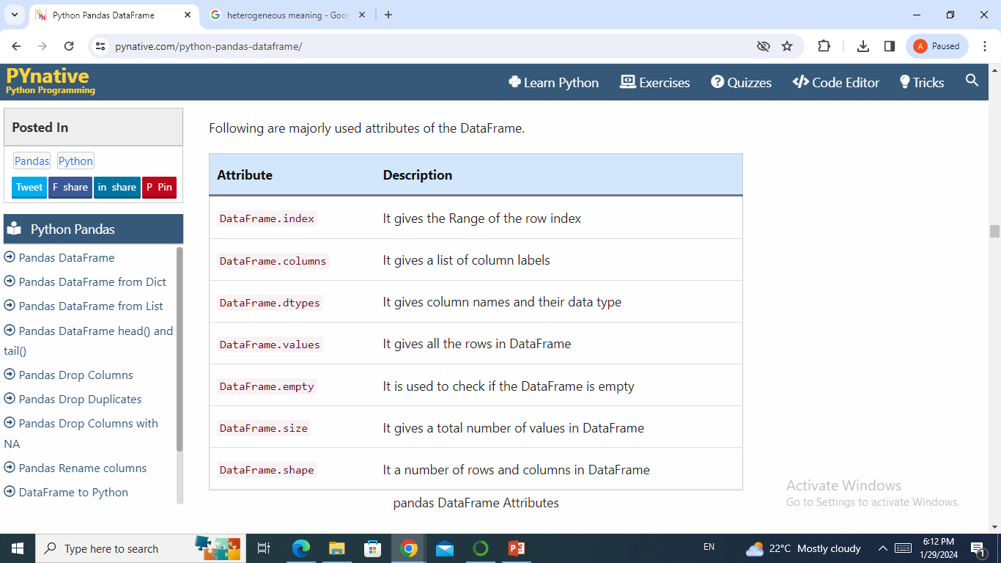
DataFrame Attributes
DataFrame has provided many built-in attributes. Attributes do not modify the underlying data, unlike functions, but it is used to get more details about the DataFrame.

Slide 8
DataFrame selection
While dealing with the vast data in DataFrame, a data analyst always needs to select a particular row or column for the analysis. In such cases, functions that can choose a set of rows or columns like top rows, bottom rows, or data within an index range play a significant role. Following are the functions that help in selecting the subset of the DataFrame.

Slide 9
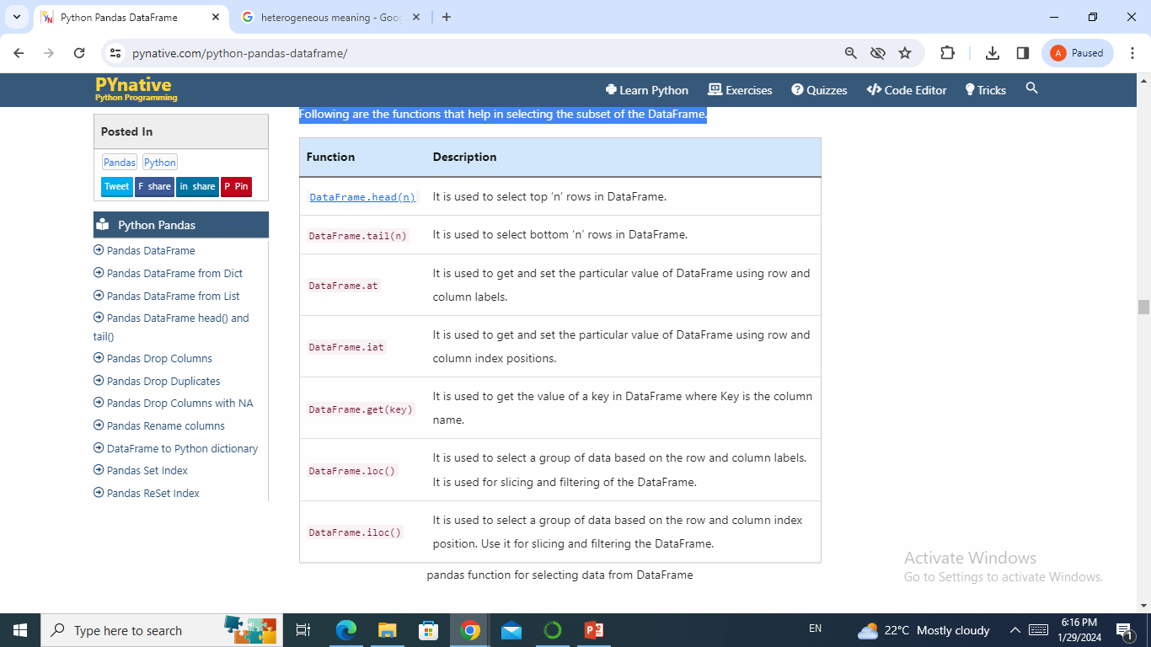

Slide 10
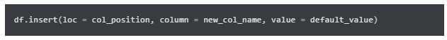
DataFrame modification
DataFrame is similar to any excel sheet or a database table where we need to insert new data or drop columns and rows if not required. Such data manipulation operations are very common on a DataFrame.
Insert columns
Sometimes it is required to add a new column in the DataFrame. DataFrame.insert() function is used to insert a new column in DataFrame at the specified position.
In the below example, we insert a new column “Class” as a third new column in the DataFrame with default value ‘A’ using the syntax:

Slide 11
Drop columns in pandas DataFrame
Datasets could be in any shape and form. To optimize the data analysis, we need to remove some data that is redundant or not required. This article aims to discuss all the cases of dropping single or multiple columns from a pandas DataFrame.
The following functions are discussed in detail:
df.drop(columns = ['col1','col2'...])
df.pop('col_name')
del df['col_name']

Slide 12
The DataFrame.drop() function
We can use this pandas function to remove the columns or rows from simple as well as multi-index DataFrame.
DataFrame.drop(labels=None, axis=1, columns=None, level=None, inplace=False,errors='raise')
Parameters:
labels: It takes a list of column labels to drop.
axis: It specifies to drop columns or rows. set a axis to 1 or ‘columns’ to drop columns. By default, it drops the rows from DataFrame.
columns: It is an alternative to axis='columns'. It takes a single column label or list of column labels as input.
level: It is used in the case of a MultiIndex DataFrame to specify the level from which the labels should be removed. It takes a level position or level name as input.
inplace: It is used to specify whether to return a new DataFrame or update an existing one. It is a boolean flag with default False.
errors: It is used to suppress KeyError error if a column is not present. It takes the following inputs: ‘ignore‘: It suppresses the error and drops only existing labels. ‘raise‘: Throws the errors if the column does not exist. It is the default case.
Returns:
It returns the DataFrame with dropped columns or None if inplace=True
It also raises KeyError if labels are not found.

Slide 13
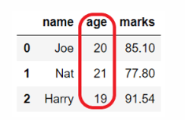
Drop single column
We may need to delete a single or specific column from a DataFrame.
In the below example we drop the ‘age‘ column from the DataFrame using df.drop(columns = 'col_name')
Drop multiple columns
Use any of the following two parameters of DataFrame.drop() to delete multiple columns of DataFrame at once.
Use the column parameter and pass the list of column names you want to remove.
Set the axis=1 and pass the list of column names.

Slide 14
Using drop with axis='columns' or axis=1
Let’s see how to drop using the axis-style convention. This is a new approach. ( This approach makes this method match the rest of the pandas API) .
Use the axis parameter of a DataFrame.drop() to delete columns. The axis can be a row or column. The column axis represented as 1 or ‘columns’.
Set axis=1 or axis='columns' and pass the list of column names you want to remove.

Slide 15
Drop column in place
Parameter inplace is used to indicate if drop column from the existing DataFrame or create a copy of it.
If the inplace=True then it updates the existing DataFrame and does not return anything.
If the inplace=False then it creates a new DataFrame with updated changes and returns it.

Slide 16
Drop column by suppressing errors
By default, The DataFrame.drop() throws KeyError if the column you are trying to delete does not exist in the dataset.
If we want to drop the column only if exists then we can suppress the error by using the parameter errors.
Set errors='ignore' to not throw any errors.
Set errors='raised' to throw KeyError for the unknown columns

Slide 17
Drop column by index position
If there is a case where we want to drop columns in the DataFrame, but we do not know the name of the columns still we can delete the column using its index position.
Note: Column index starts from 0 (zero) and it goes till the last column whose index value will be len(df.columns)-1 .
Drop the last column
Assume you want to drop the first column or the last column of the DataFrame without using the column name.
In such cases, use the DataFrame.columns attribute to delete a column of the DataFrame based on its index position. Simply pass df.columns[index] to the columns parameter of the DataFrame.drop().

Slide 18
Drop range of columns using iloc
There could be a case when we need to delete the fourth column from the dataset or need to delete a range of columns. We can use DataFrame.iloc to select single or multiple columns from the DataFrame.
We can use DataFrame.iloc in the columns parameter to specify the index position of the columns which need to drop.
Drop first n columns
If we need to delete the first ‘n’ columns from a DataFrame, we can use DataFrame.iloc and the Python range() function to specify the columns’ range to be deleted.
We need to use the built-in function range() with columns parameter of DataFrame.drop().

Slide 19
Drop column using pandas DataFrame.pop() function
If we want to delete a single column then we can also do that using DataFrame.pop(col_label) function. We need to pass a column label that needs to delete.
It removes the column in-place by updating the existing DataFrame. It raises KeyError if the column is not found.
Note: It can be used to drop a column only. It cannot drop multiple columns or row(s).
Drop column using pandas DataFrame delete
We can also use the pandas inbuilt function del to drop a single column from a DataFrame. It is a very simplified way of dropping the column from a DataFrame.
We need to select the column of DataFrame which needs to be deleted and pass it as del df[col_label].

Slide 20
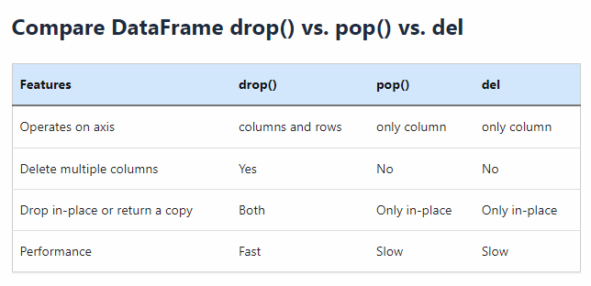

Slide 21
Drop duplicates in pandas DataFrame

Slide 22

Drop duplicates in pandas DataFrame
Data is gathered from various sources. It may not be in the proper form. It contains garbage values and duplicate data. Before analyzing a dataset, it must be clean and precise.
The DataFrame.drop_duplicates() function
This function is used to remove the duplicate rows from a DataFrame.

Slide 23
Parameters:
subset: By default, if the rows have the same values in all the columns, they are considered duplicates. This parameter is used to specify the columns that only need to be considered for identifying duplicates.
keep: Determines which duplicates (if any) to keep. It takes inputs as, first – Drop duplicates except for the first occurrence. This is the default behavior. last – Drop duplicates except for the last occurrence. False – Drop all duplicates.
inplace: It is used to specify whether to return a new DataFrame or update an existing one. It is a boolean flag with default False.
ignore_index: It is a boolean flag to indicate if row index should be reset after dropping duplicate rows. False: It keeps the original row index. True: It reset the index, and the resulting rows will be labeled 0, 1, …, n – 1.

Slide 24
Drop duplicates but keep first
When we have the DataFrame with many duplicate rows that we want to remove we use DataFrame.drop_duplicates().
The rows that contain the same values in all the columns then are identified as duplicates. If the row is duplicated then by default DataFrame.drop_duplicates() keeps the first occurrence of that row and drops all other duplicates of it.
Drop duplicates from defined columns
By default, DataFrame.drop_duplicate() removes rows with the same values in all the columns. But, we can modify this behavior using a subset parameter.
For example, subset=[col1, col2] will remove the duplicate rows with the same values in specified columns only, i.e., col1 and col2.

Slide 25
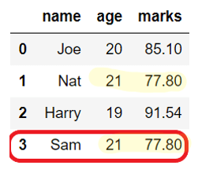
Example
In the below example, rows for ‘Nat’ and ‘Sam’ are removed even though their names are different because only ‘age‘ and ‘marks‘ columns are considered to check for duplicates.

Slide 26
Drop duplicates but keep last
Let’s consider the case where we have a row that is duplicated multiple times in the DataSet. In such a case, To keep only one occurrence of the duplicate row, we can use the keep parameter of a DataFrame.drop_duplicate(), which takes the following inputs:
first – Drop duplicates except for the first occurrence of the duplicate row. This is the default behavior.
last – Drop duplicates except for the last occurrence of the duplicate row.
False – Drop all the rows which are duplicate.

Slide 27
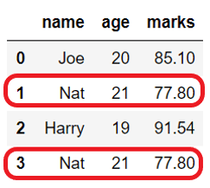
Drop all duplicates
As explained in the above section, by default, DataFrame.drop_duplicates() keeps the duplicate row’s first occurrence and removes all others.
If we need to drop all the duplicate rows, then it can be done by using keep=False, as shown below.
Example

Slide 28
Drop duplicates in place
By default, DataFrame.drop_duplicates() removes the duplicates and returns the copy of the DataFrame.
But, if we want to make changes in the existing DataFrame, then set the flag inplace=True. It can be used when the drop operation is part of the function chaining.

Slide 29
Drop duplicates and reset the index
When we drop the rows from DataFrame, by default, it keeps the original row index as is. But, if we need to reset the index of the resultant DataFrame, we can do that using the ignore_index parameter of DataFrame.drop_duplicate().
If ignore_index=True, it reset the row labels of resultant DataFrame to 0, 1, …, n – 1.
If ignore_index=False it does not change the original row index. By default, it is False.

